Slide 1
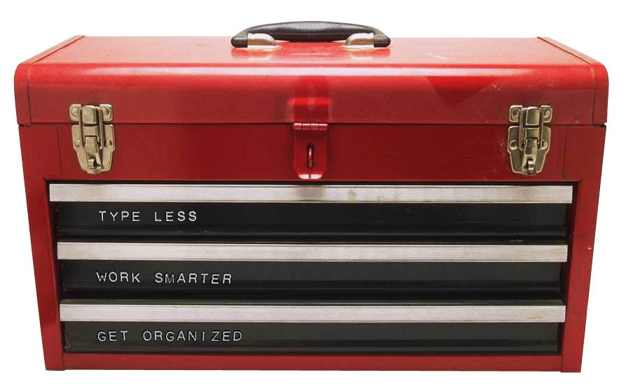
if you are looking for the
DIGGING INTO THE DEVELOPER TOOLBOX
GET LAZY: AUTOMATE! presentation – you are in the right room…
Notes:
Toolbox
Intro slide while people walk in room

Slide 2
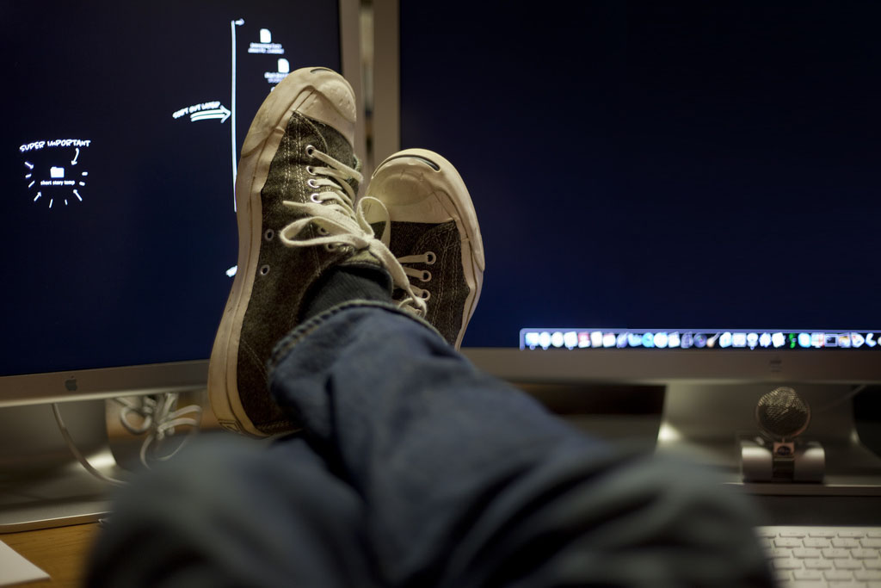
GET LAZY: AUTOMATE! Digging Into The Developer Toolbox
Jim Priest
cf.Objective() 2011
Notes:
Feet On Desk
Introduction

Slide 3
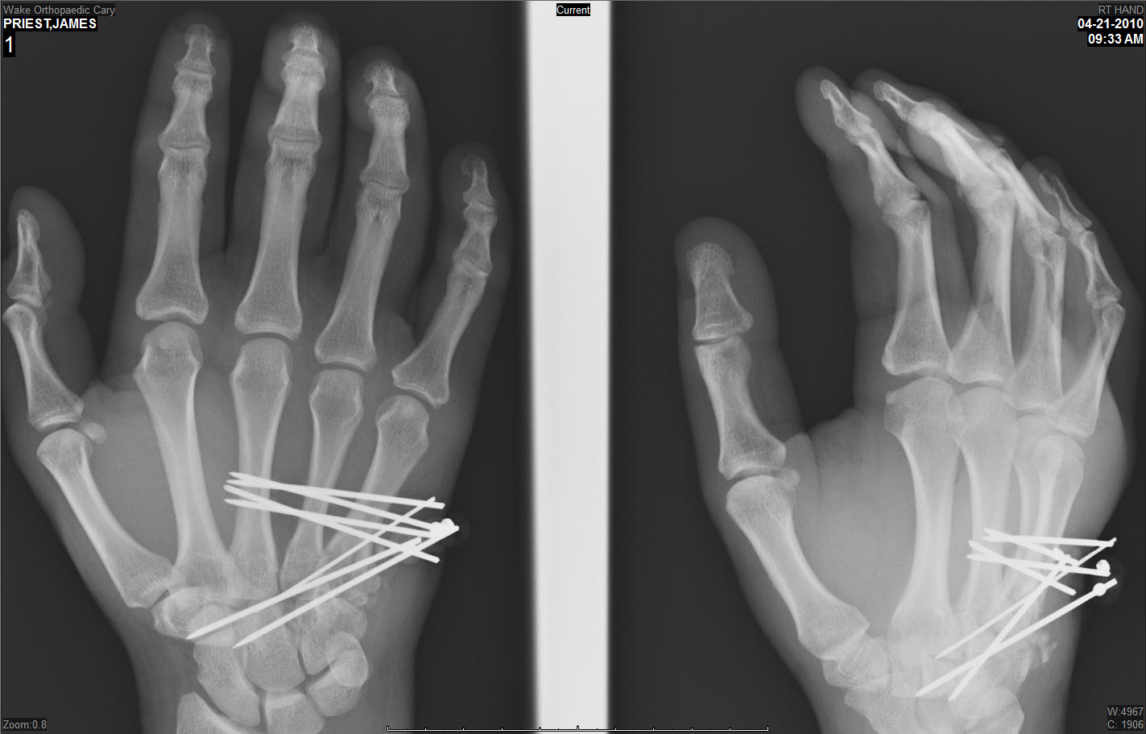
THIS SOUNDS
FAMILIAR…
WEREN’T YOU
SUPPOSED TO BE HERE LAST YEAR?
@thecrumb (twitter)
priest@thecrumb.com
TACFUG
NCDevCon
CFEclipse
Ant Wiki
Notes:
Podium
Introduction – Who am I and why am I so lazy
Presentation overview

Slide 4
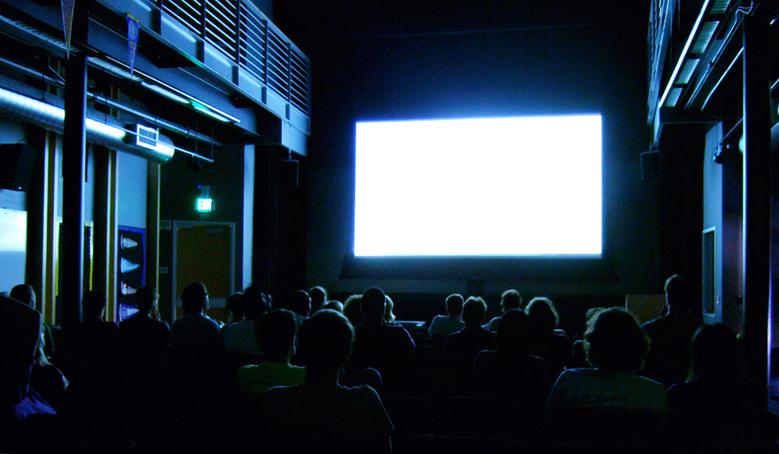
Type More
Get Organized
Work Smarter
Notes:
Podium
Introduction – Who am I and why am I so lazy
Presentation overview

Slide 5
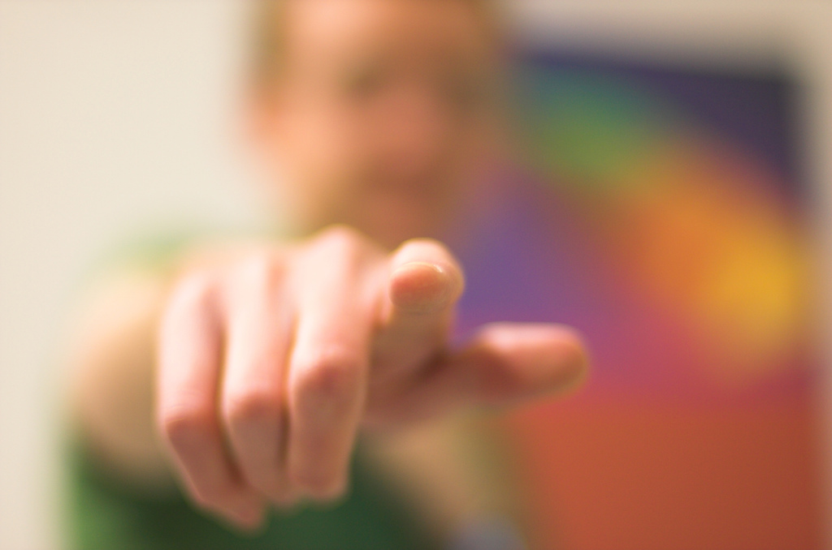
Main Entry: au·to·mate
Pronunciation: \ˈȯ-tə-ˌmāt\
Function: verb
To convert to largely automatic operation
Notes:
Finger Pointing With Definition
Why automate?
We are constantly improving code, processes, hardware, etc. but rarely improve yourself
It’s not what we are automating
But who!

Slide 6
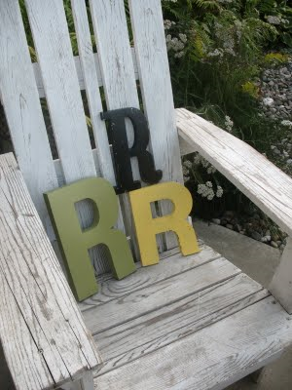
Repetition
Resolution
Re-evaluate
Notes:
Three R’s
Learning new things is hard!!!!!!
IDE switch (ColdFusion Builder anyone????), new programming languages, etc. are all things we struggle to learn as developers
Training ourselves take a lot of work…
Repetition – it’s not fun but we know if we do things over and over again it will be drilled into our brains
Resolution – stick with it! Sometimes learning new techniques is difficult! But the payouts at the and will be rewarding!
Re-evaluate – constantly reevaluate your tools and techniques. There is always something new out there!s

Slide 7
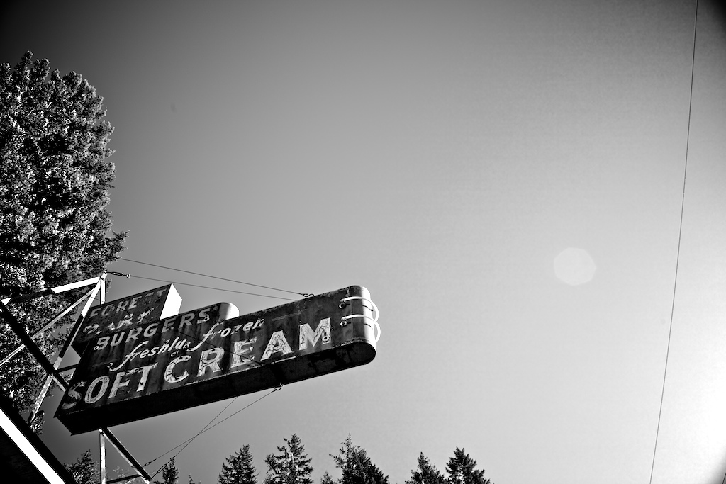
“Lost time is never found again.”
Benjamin Franklin
Notes:
Ice Cream Sign – Time Savings
Main reason to automate?
Saving time!
How many people walked here tonight?
Why not?

Slide 8
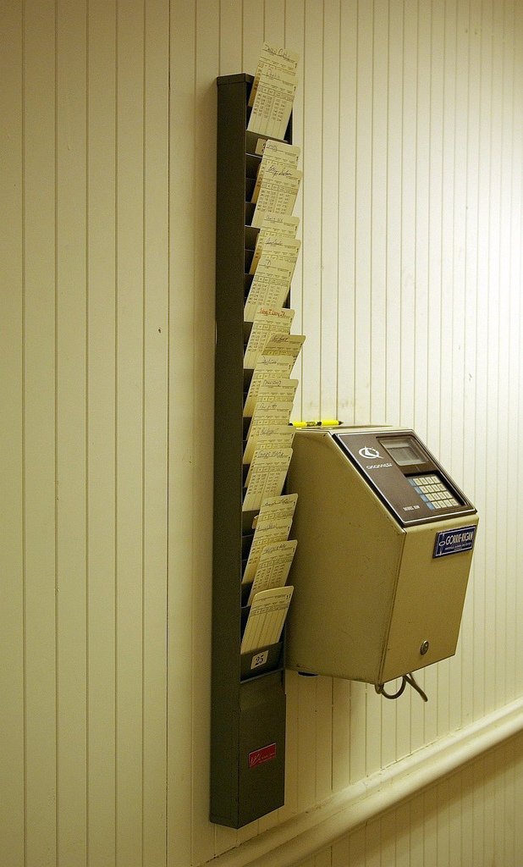
1 TASK = 6 SECONDS
10 TIMES PER DAY = 1 MINUTE
EACH WEEK = 5 MINUTES
EACH YEAR = 4 HOURS
1 TASK
Notes:
Time Card Machine – Time Savings
How many of these small repetitive tasks do you do every day??
insert cfdump/cfabort
create a new function
- type the same thing you did yesterday from scratch

Slide 9
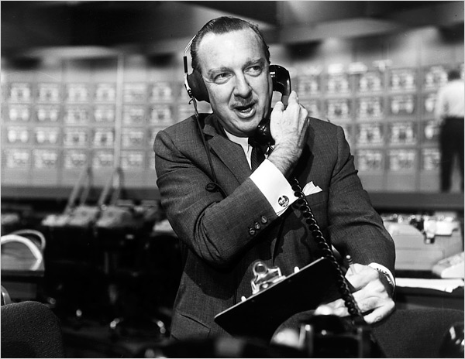
CLIPBOARD
Notes:
Walter Cronkite
Clipboard
Exit to demo - Notepad

Slide 10
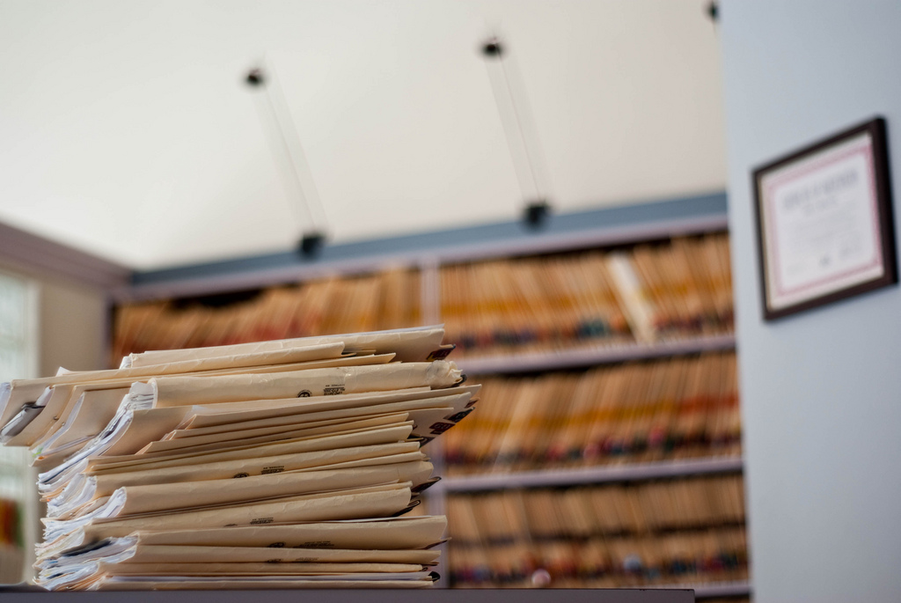
GET ORGANIZED
Notes:
VIRTUAL DESKTOPS
LAUNCHERS

Slide 11
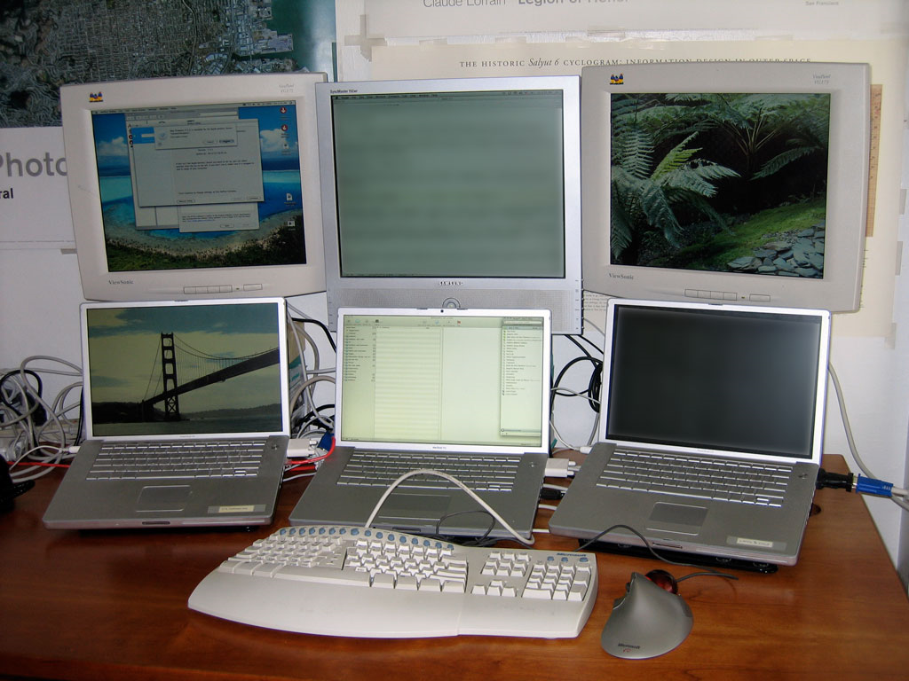
Notes:
Virtual Desktops
Dexpot

Slide 12
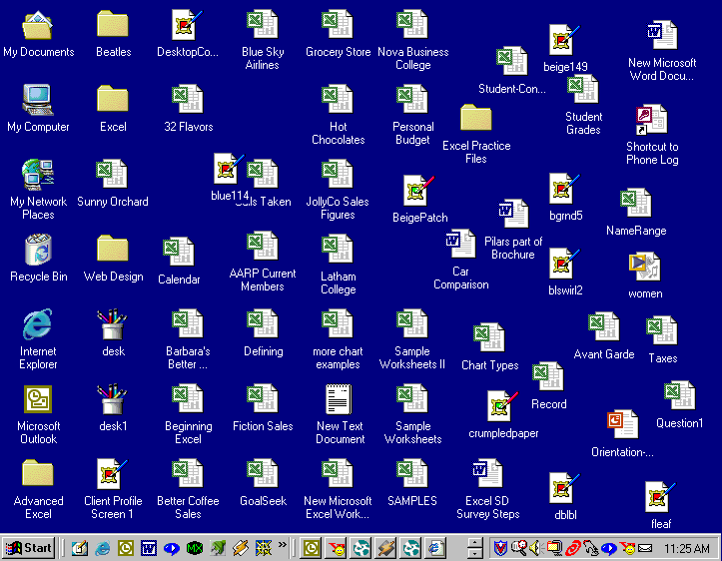
Notes:
Messy Desktop – Get Organized
Launchers
Dropbox

Slide 13
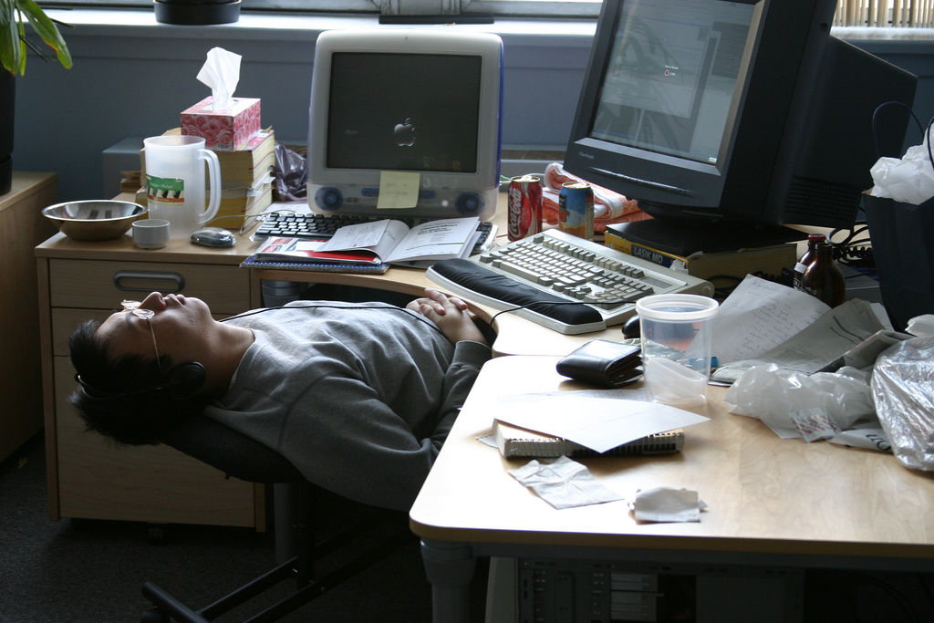
TYPE MORE
Notes:
Sleeping At Desk – Type Less!
Where do we spend most of our day
Sitting in front of a computer TYPING!
Mouse is evil! Typing = keyboard.
Taking your hands away from the keyboard = what? Lost time!
FORMS
SNIPPETS
AUTOHOTKEY

Slide 14
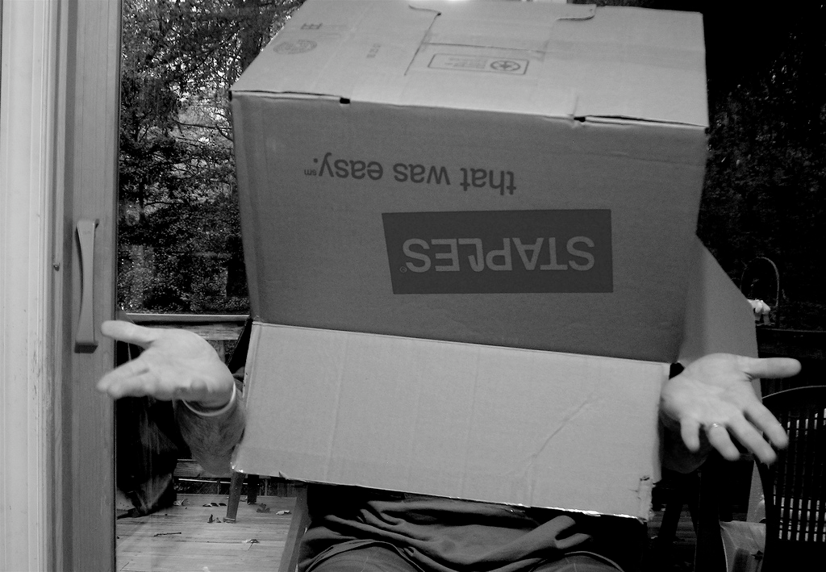
WORK SMARTER
( think outside the you know what )
Notes:
Man Wearing Box – Work Smarter
THINK OUTSIDE THE BOX
How can we leverage the tools WE ALREADY KNOW to do different things. We are all creative programmers!!
Windows scheduler
Ant
Dropbox
ColdFusion + Selenium example – cfeclipse wiki spam cleanup

Slide 15
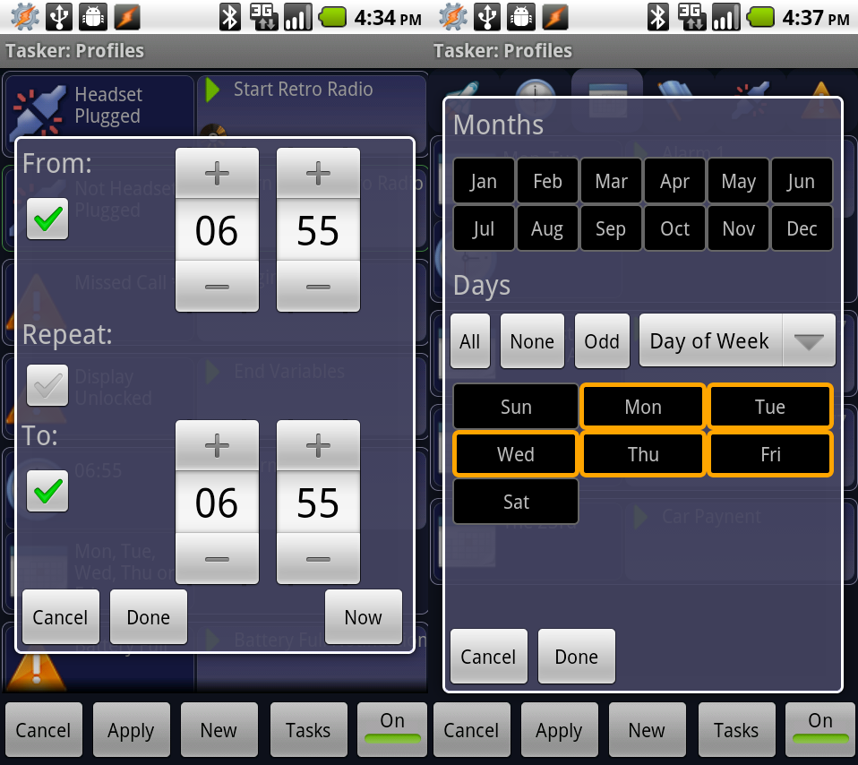
Notes:
TASKER – fun phone stuff!

Slide 16
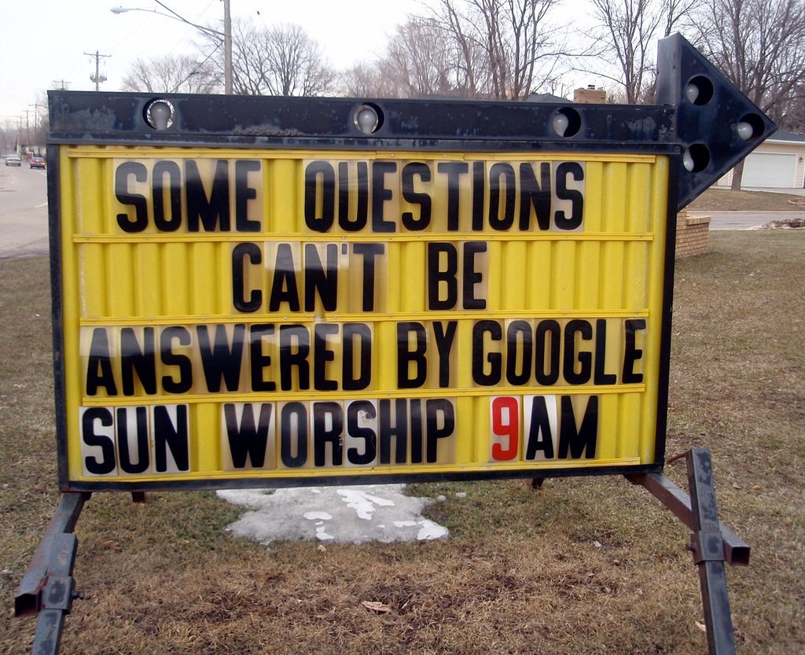
(please fill out feedback form)
http://www.cfobjective.com/index.cfm/sessions/digging-into-the-developer-toolbox/
Notes:
Church Sign
Question?????????

Slide 17
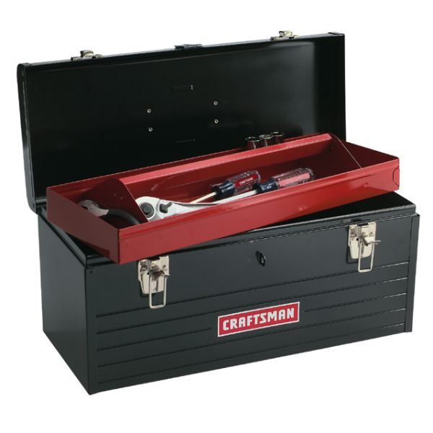
Built by: Jim Priest
email: priest@thecrumb.com
blog: thecrumb.com
Photo Credits *
feet on desktop photo - delgrosso
lecturn - David Gallagher
Movie screen - ToastyKen
3 letter R's - http://junk-fest.blogspot.com/2009/08/junk-fest-its-all-about-three-rs.html
time card machine - House Of Sims
ice cream sign - frozenchipmunk
finger pointing - Chris Owens
sleeping dog - wikipedia commons
asleep at desk - sfllaw
Walter Cronkite - John McNab
java code- Dmitry Baranovskiy
Monitors - Jose C Silva
Files - geekstinkbreath
man in box - Earl - What I Saw 2.0
question sign - Mykl Roventine
* All photos from flickr unless noted otherwise
Notes:
Question?????????

